Slide 1

T130 Achievement T131 Target Goal Dream
TDK Philippines Corporation
A TDK Group Company
Laguna, Philippines
(BMS) DEVELOPMENT
September 2025
Lans Jeffrey Galos

Slide 2
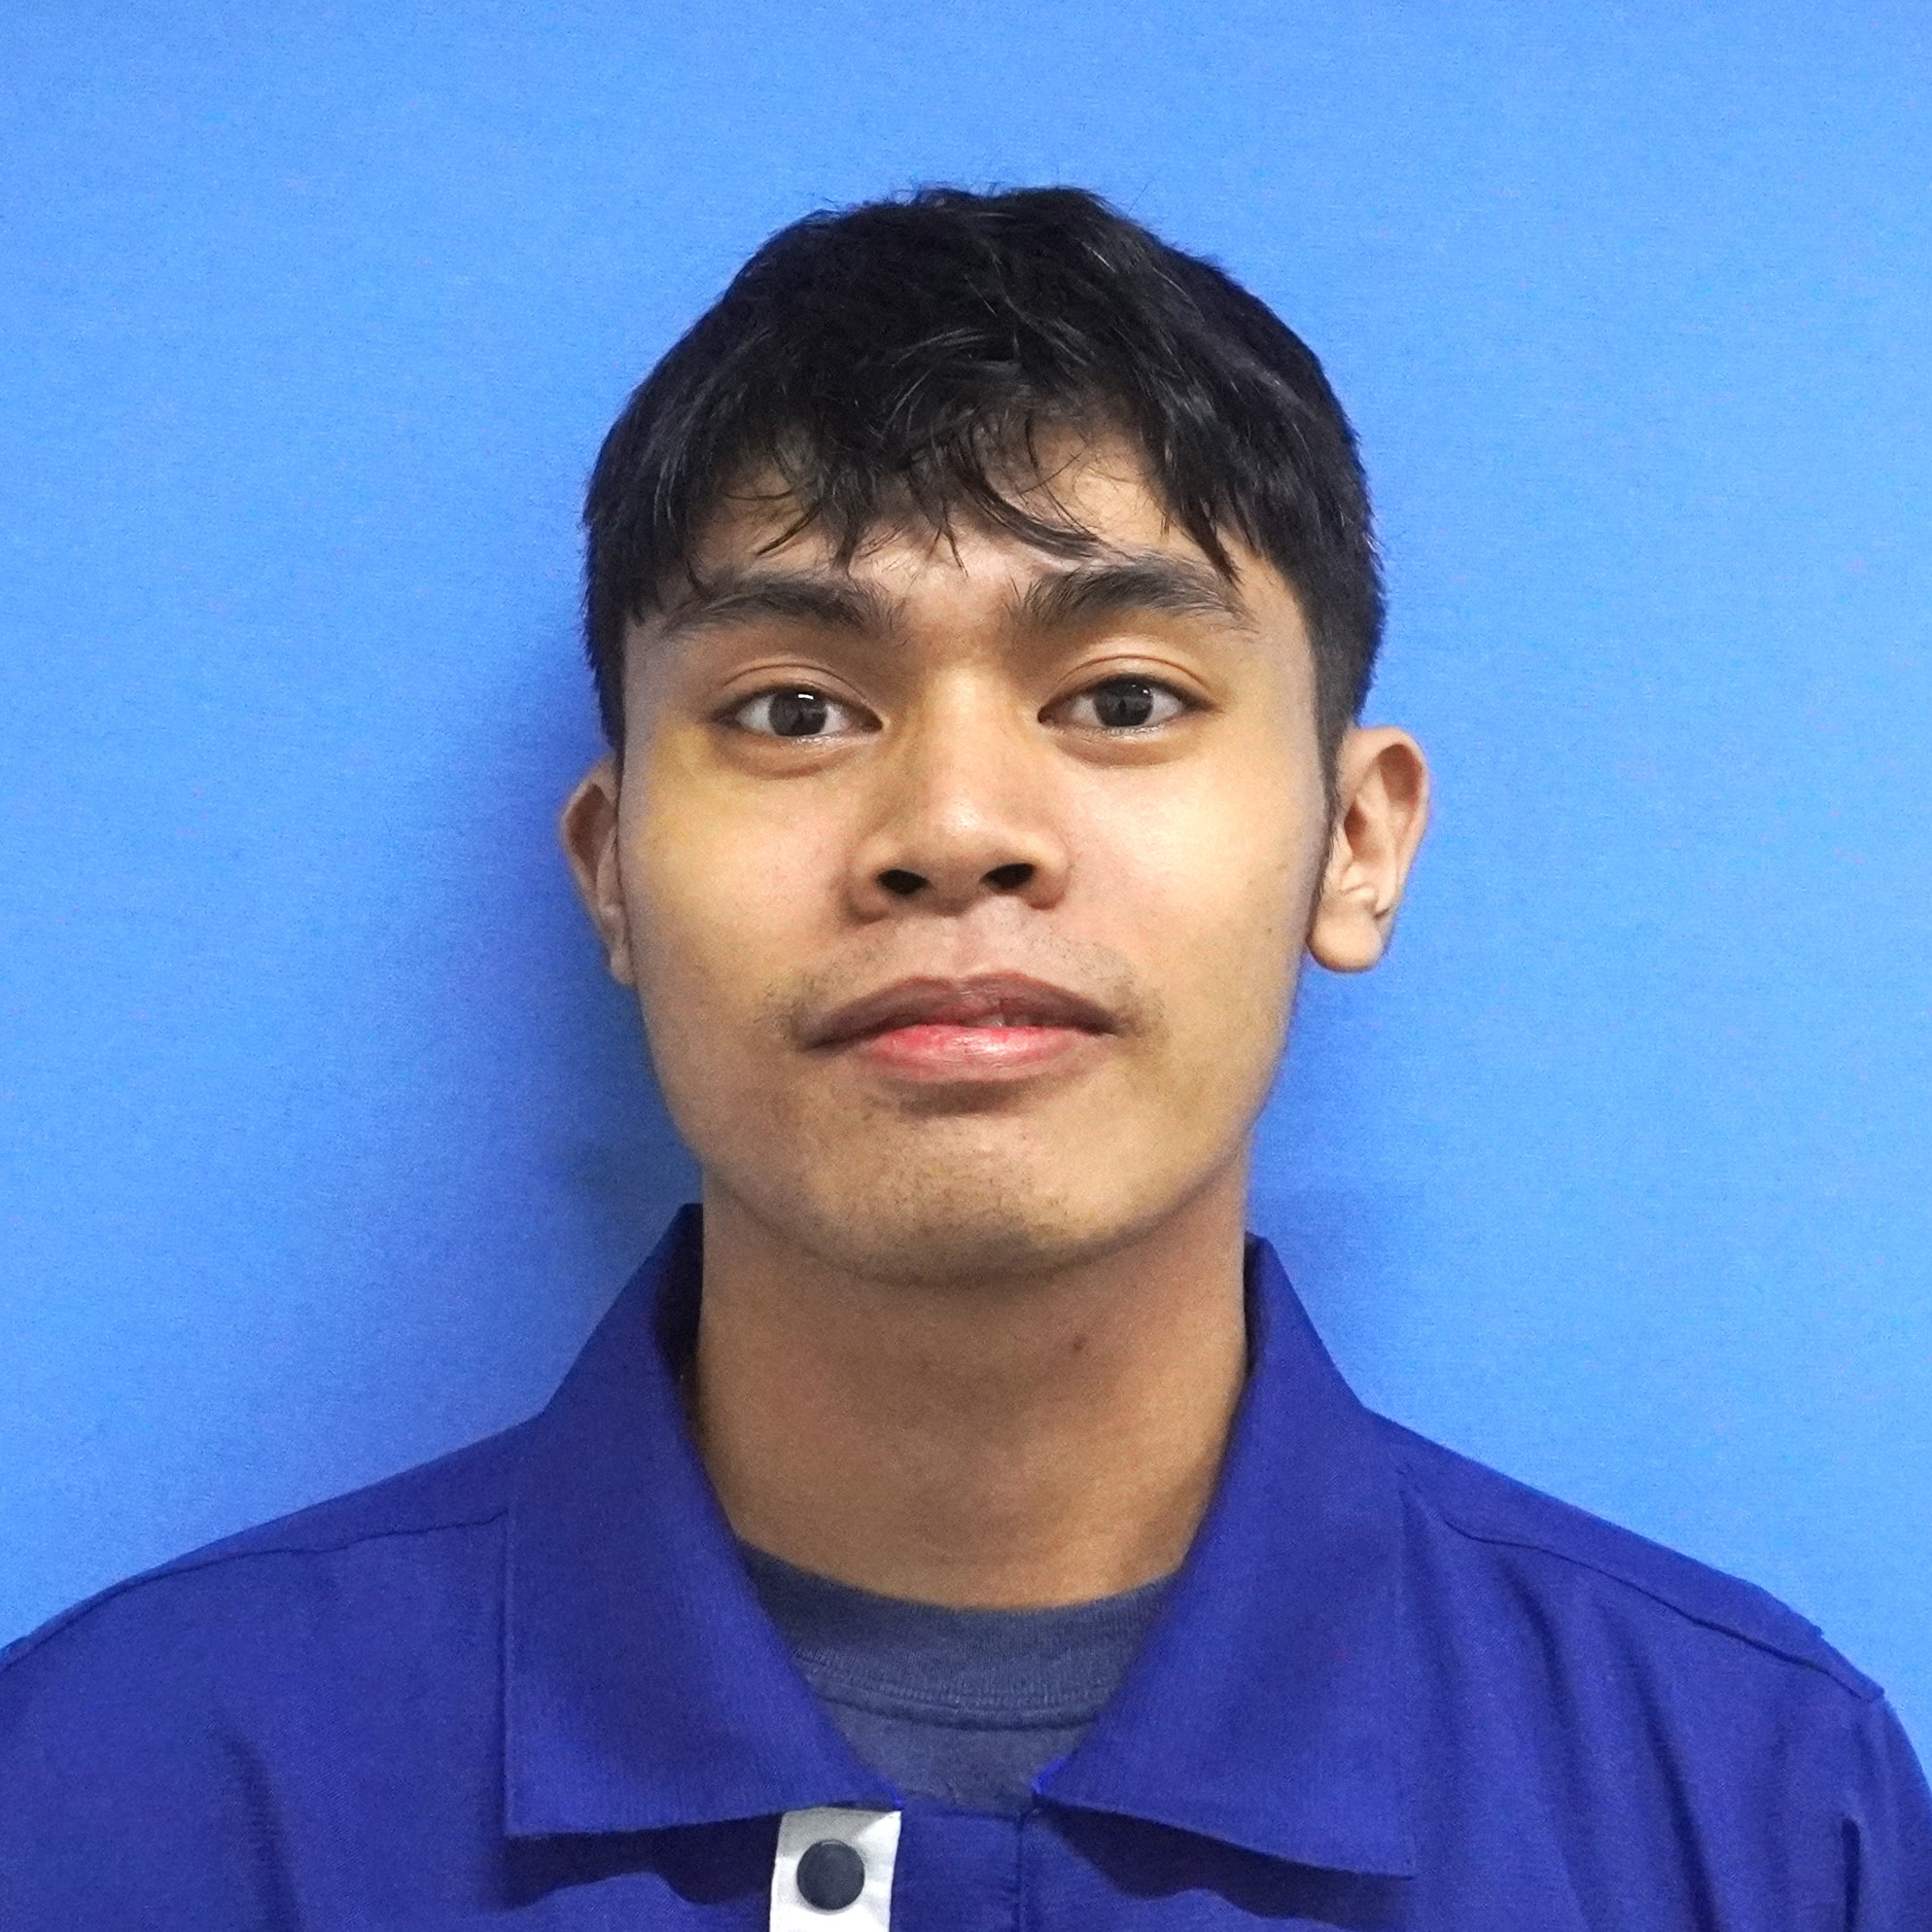
Name: Lans Jeffrey L. Galos
Position: Associate Technician

Slide 3
T130 Target
TDK Philippines Corporation
A TDK Group Company
Laguna, Philippines
(BMS) DEVELOPMENT
September 2025
Lans Jeffrey Galos

Slide 4
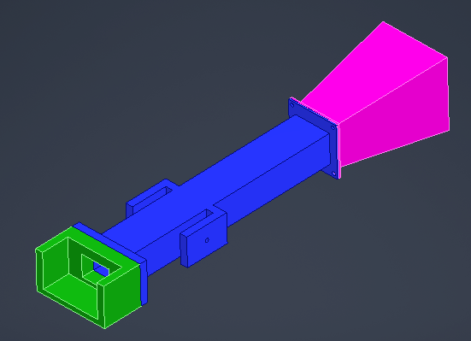
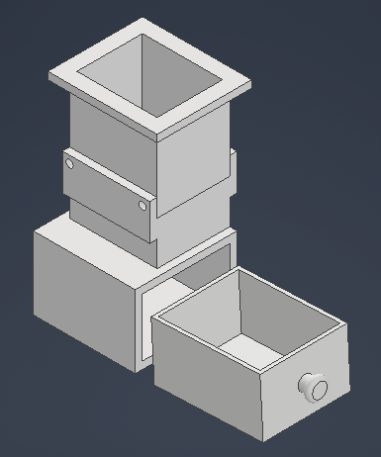
Other Activities
Exhaust Fan Holder 3D Model Improvement:
Status: For review
Result: Designed and Drawn the 3D Model
3D Model Trash Drawer for Semi Auto Coil Winding Machine:
Status: For review
Result: Designed and Drawn the 3D Model

Slide 5
Dream
TDK Philippines Corporation
A TDK Group Company
Laguna, Philippines
(BMS) DEVELOPMENT
September 2025
Lans Jeffrey Galos

Slide 6
Other Activities
Exhaust Fan Holder 3D Model Improvement:
Status: For review
Result: Designed and Drawn the 3D Model
3D Model Trash Drawer for Semi Auto Coil Winding Machine:
Status: For review
Result: Designed and Drawn the 3D Model

